Slide 1
TaxSlayer® Practice Lab
An Introduction

Slide 2
TaxSlayer Practice Lab
Most internet browsers work
  Internet Explorer 8.0 or higher
  Google Chrome
  Safari Browser 5.1
For Practice Lab
  https://vita.taxslayerpro.com/
  https://vita.taxslayerpro.com/IRSTraining
  https://www.linklearncertification.com
Notes:
When you first enter the url, it will show as expanded as follows: https://vita.Taxslayerpro.com/IRSTraining/en/account/access.
TaxSlayer does not recommend using Firefox due to its weak firewalls that can be easily compromised.
linklearncertification.com recommended. Use the one site to access Practice Lab and certification tests.
Firefox really does very well.

Slide 3
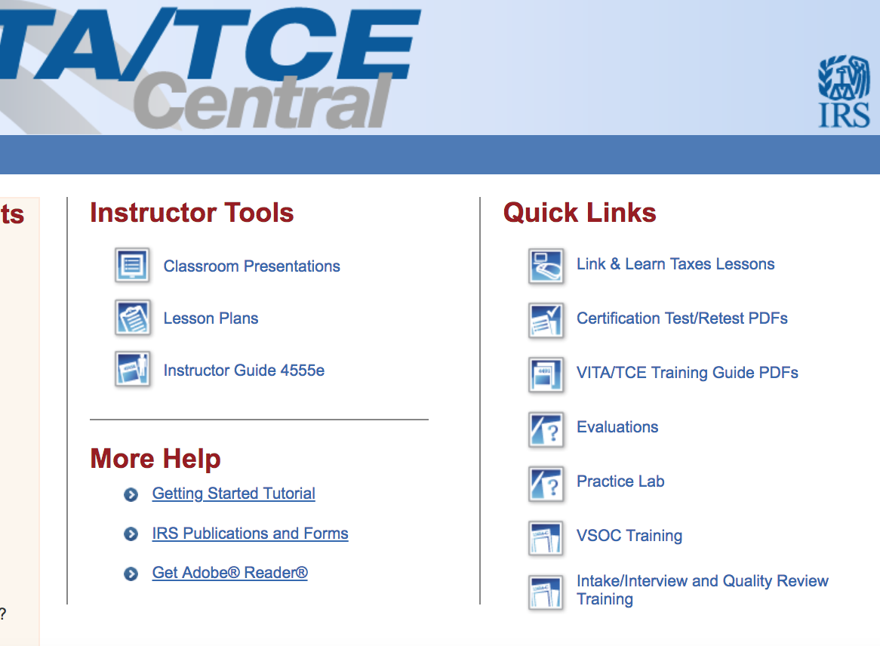
https://www.linklearncertification.com
Link and Learn
Practice Lab
Notes:
Must have established account

Slide 4
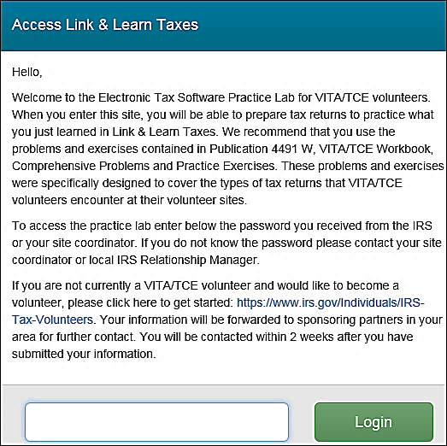
First Time Practice Lab Login
Enter Universal password: TRAINPROWEB
Notes:
Process for logging into production is different and is explained in the brain shark video in section 1 - Pro Online Login and password
All videos cover TaxSlayer production not Practice Lab – there are a few differences
Multi Factor Authentication is not required for Practice Lab
All practice lab users must have a password that is a minimum of 15 characters in length and includes both upper and lower case characters, at least 1 number and one special character
The password will expire after 90 days

Slide 5
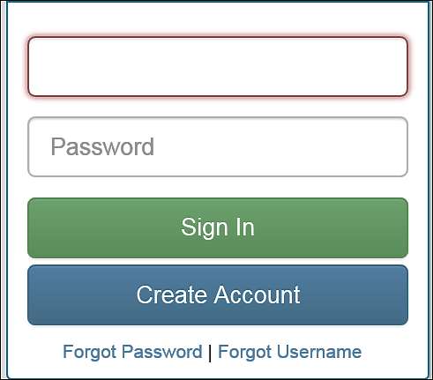
Creating an Account in Practice Lab
Select: Create Account

Slide 6
Creating an Account in Practice Lab
Enter e-mail address twice
Create a user name
Create a password
  Alphanumeric with at least 15 characters, both upper and lower case, and one special character
Enter password twice
Password will expire after 90 days
Notes:
Your Instructors may advise you to use a certain User Name
It is suggested to include Train or Practice or PL in the user name
It is not necessary, but you will NOT use this password anywhere other than Practice lab

Slide 7
Creating an Account in Practice Lab
Select “AARP Tax-Aide” from “Program Type” drop down window
Enter SIDN if known, not required
Select security question
Enter answer to security question
Notes:
Depending on district, answer to security question is the same for all counselors in the district.

Slide 8
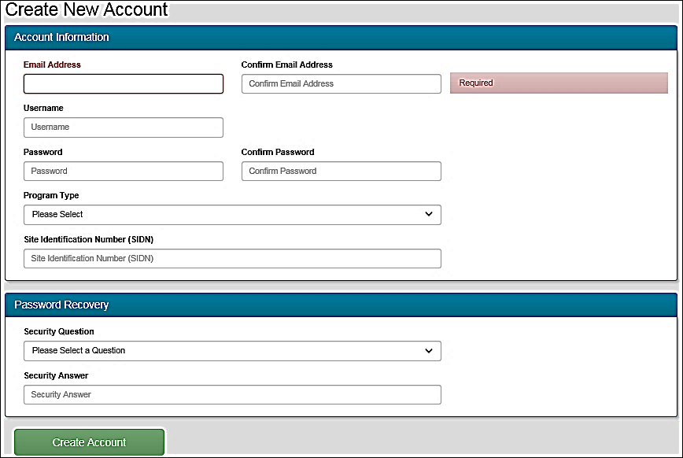
Creating an Account in Practice Lab
Make a record of your password and security answer
Notes:
E-mail Address: Practice Lab displays a warning if you have previously used an email address in the Practice Lab system.
User Name: Use either Train or Practice in the user name. All user names in TaxSlayer Pro Online must be unique in all online platforms so User Name for Practice Lab cannot be used for Production. Practice Lab displays a warning if the user name has been created by another volunteer.
Password: For both the practice lab and the production software, the password is case sensitive and must be at least 15 characters long with at least one upper case letter, 1 lower case letter, 1 number and one special character. These requirements are based on the trusted customer requirements issued by the IRS security summit.
Program Type: Select AARP Tax-Aide from the drop-down list.
Site Identification Number (SIDN): Type in SIDN if you know it – not required
Security Question: Select a security question n from the list.
Security Answer: Type the answer to your security question.
Click Create Account

Slide 9
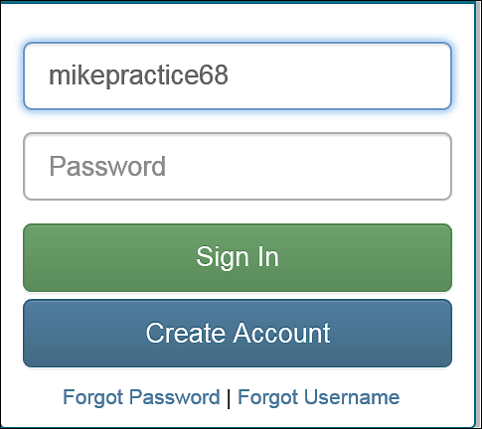
Practice Lab Login
First time you log in your user name will be shown
Enter password you just created and click on Sign in

Slide 10
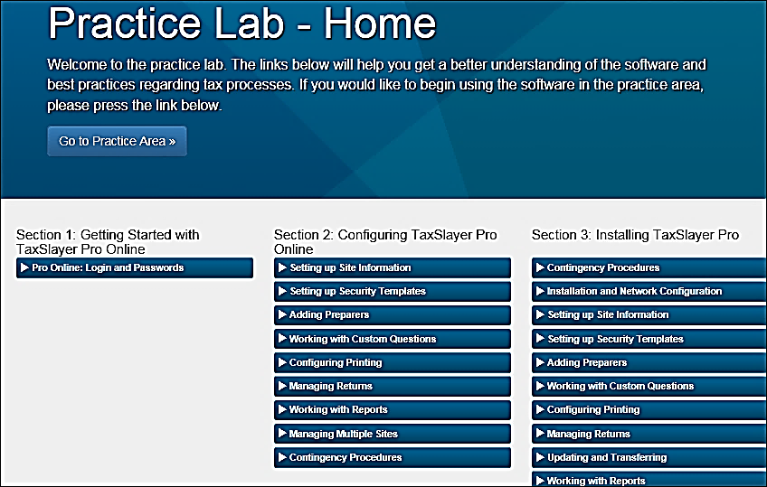
Exploring TaxSlayer: BrainShark Videos
Create a Practice Return
BrainShark Videos
Notes:
Practice Lab – Home: Access TaxSlayer Practice Lab by clicking on ‘Go to Practice Area’. All practice returns will have 00 as middle two Social Security numbers
Section 1: Getting started with TaxSlayer Pro Online. The Pro Online Login and Passwords video provides you with information about how to long into the production version of TaxSlayer Pro, NOT the practice lab
Section 4: Preparing a Return. Videos explain how to enter taxpayer data into TaxSlayer

Slide 11
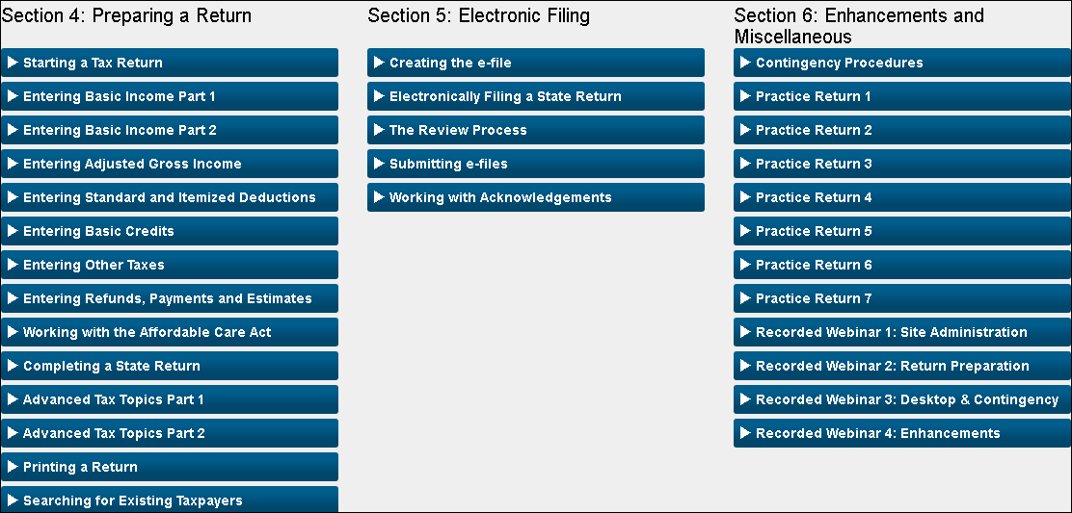
Exploring TaxSlayer: BrainShark Videos
Notes:
Section 4 contains videos detailing how to prepare a return and should be reviewed as training.
Section 5 covers e-filing. Since you cannot submit an e-file in Practice Lab, the last 2 videos in this section do not apply to Practice Lab.
Section 6 contains practice returns and 4 recorded webinars prepared by TaxSlayer. Recommend NTTC Workbook 2018
Instructor options:
Assign videos as homework or review videos in class
Interactive – Instructors demo and counselors follow along in TaxSlayer
Short quiz after each Video to check for understanding

Slide 12
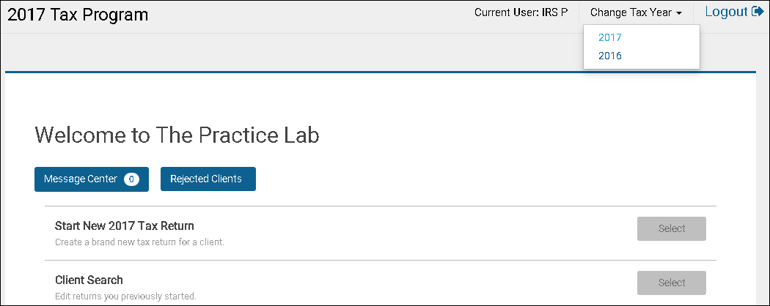
Practice Lab: Beginning a Practice Return
Defaults to current year
Can choose a different year
Notes:
You will arrive at this welcome page if you select “Go to Practice Area” instead of selecting a video
To start a new 2018 return select, “Start New Tax Return”.
To review a 2018 return already created select, “Client Search”.
To start a new 2017 return or review a 2017 return already created, select “Change Tax Year” in the upper right hand corner of screen and then select 2017 from the dropdown window.
Until each state approves the TaxSlayer software, you MUST use 2017 to create a state return.

Slide 13
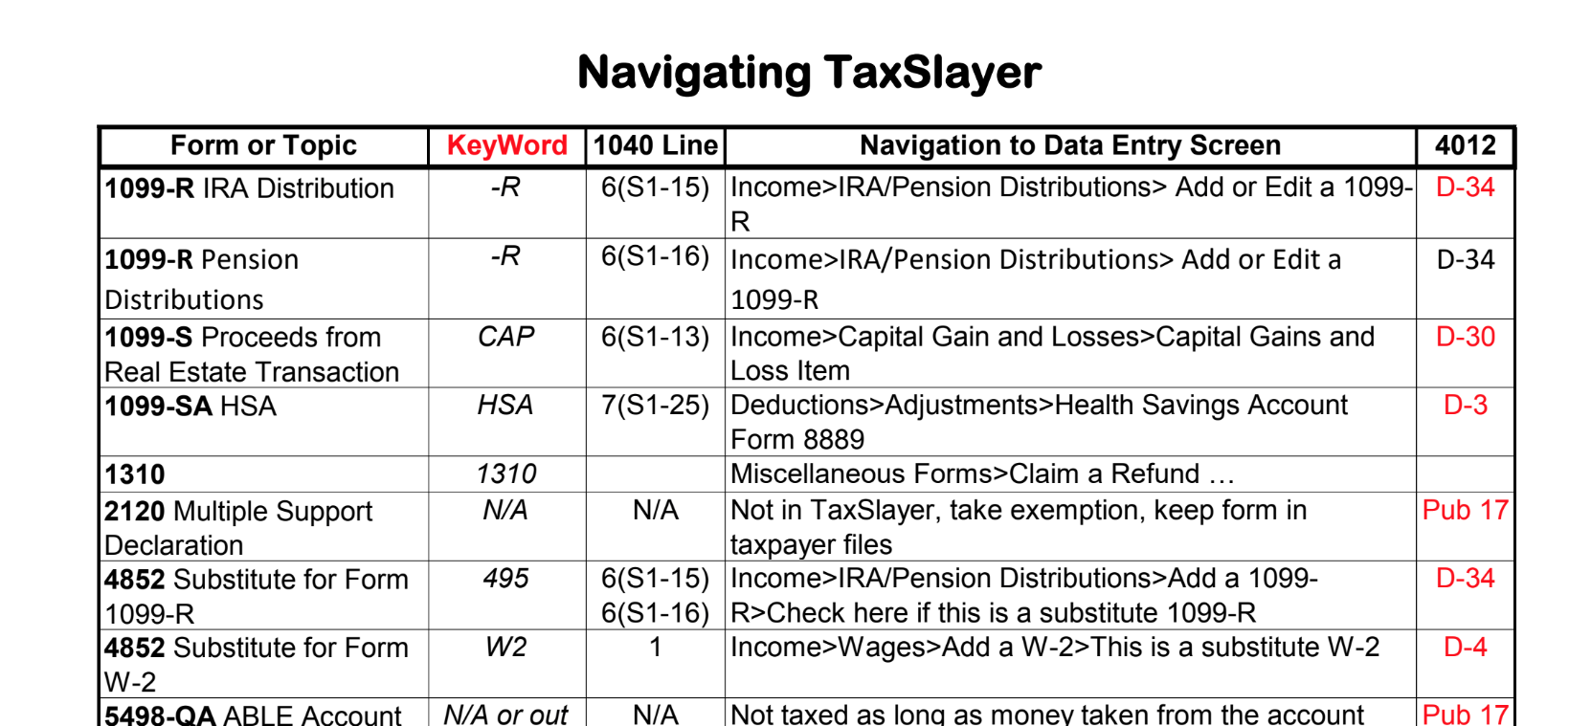
TaxSlayer and Volunteer Resource Guide Pub 4012
Pub 4012 Tab O
Pub 4012 Tab O provides TaxSlayer Navigation and instruction
Notes:
Information in Pub 4012 Tab O is designed for TaxSlayer Pro Online. However, information available in Pub 4012 Tab O will help navigate Practice Lab

Slide 14
TaxSlayer and Volunteer Resource Guide Pub 4012
Where can you find information about entering state returns in TaxSlayer in the Volunteer Resource Guide?
Tab O Page 5
Notes:
Practice using Pub 4012

Slide 15
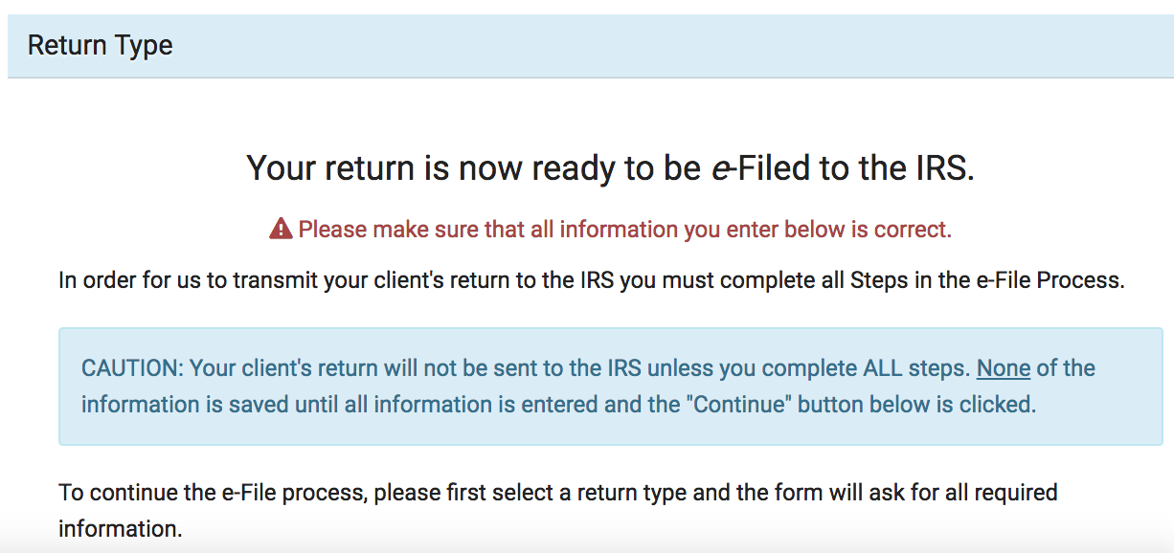
E-Filing in TaxSlayer
Notes:
This page indicates the return has passed diagnostics and is ready to be e-filed
BrainShark video ‘Creating the E-File’ details entering direct deposit and direct debit bank information along with how to complete the e-file screens in TaxSlayer

Slide 16
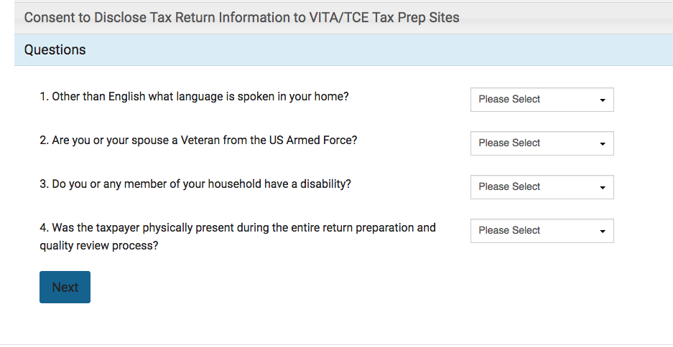
E-Filing in TaxSlayer and AARP Grant Questions
Notes:
Replace with current year AARP questions when available
AARP receives grants to fund the Tax-Aide program. Those grants are based on demographics served. AARP requests information from taxpayers to support funding requests. While taxpayers are not required to answer these questions, when answers are provided, record taxpayer’s answers in the e-file section of the return.

Slide 17
TaxSlayer/Training
Questions…
Comments…

